Slide 1
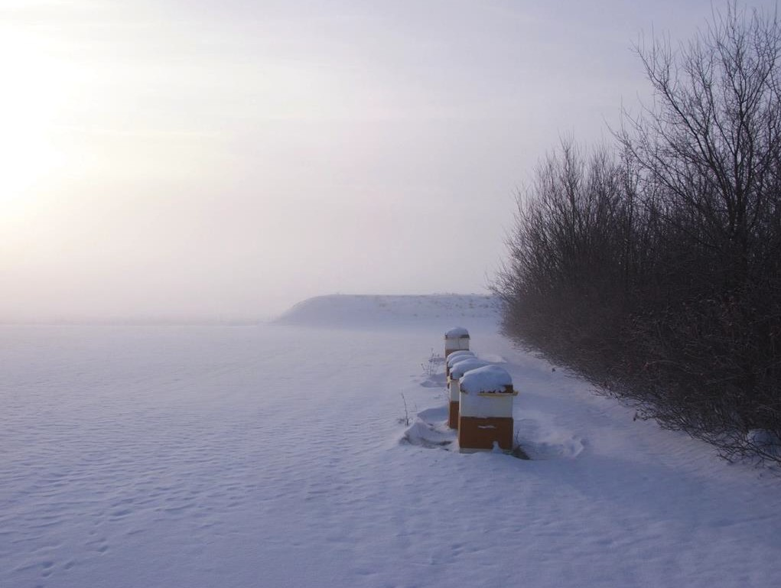
AU
AARHUS UNIVERSITY
Beekeeping in Denmark
What is similar, what is different?
Per Kryger, Agroecology, Aarhus University
4200 Slagelse Denmark

Slide 2
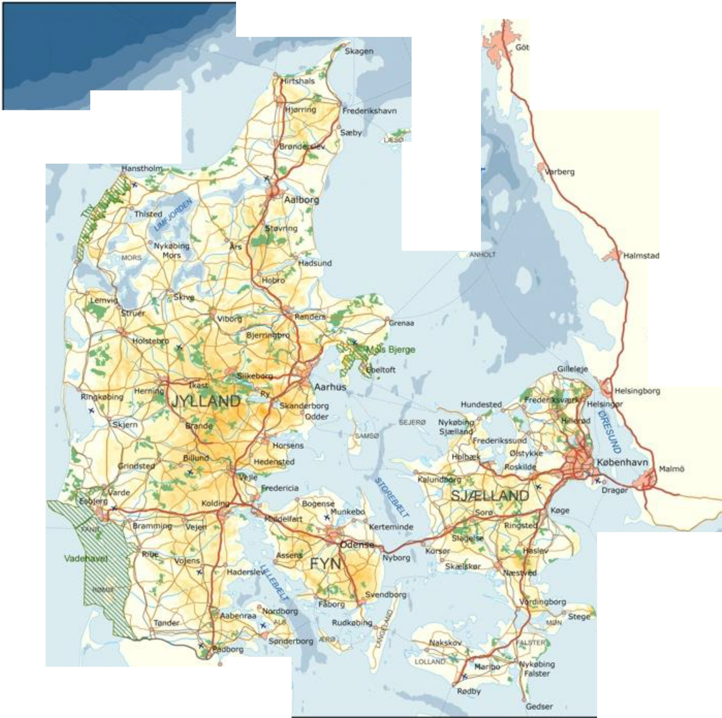

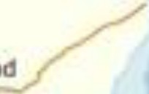
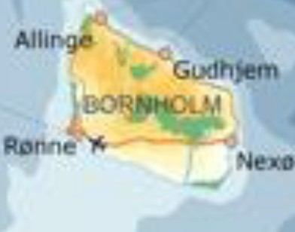
KAG RRAK
KATTEGA
SV RIGE
TER 0 N
lm,;borg
TYSKLAND

Slide 3
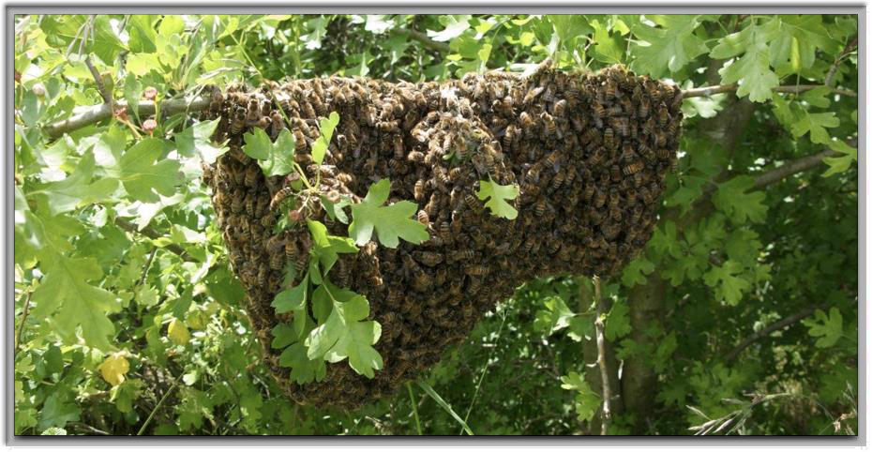
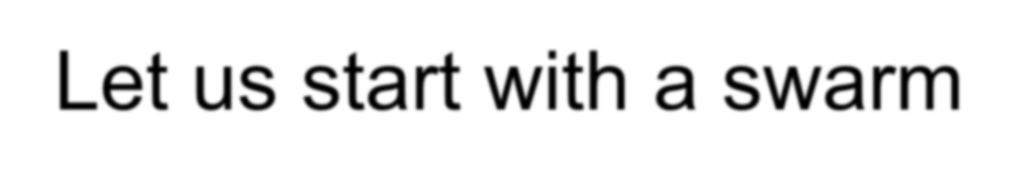
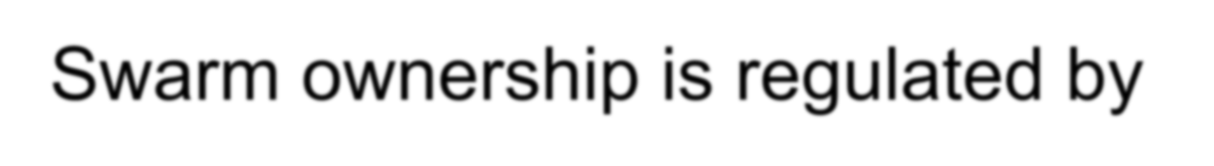
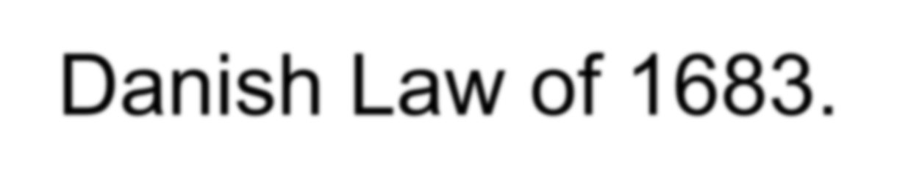
Let us start with a swarm
Swarm ownership is regulated by Danish Law of 1683.

Slide 4
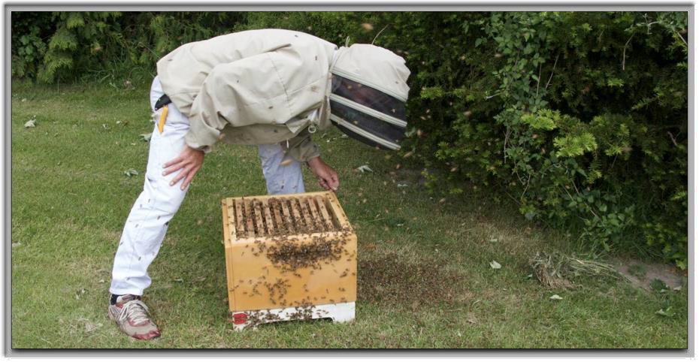

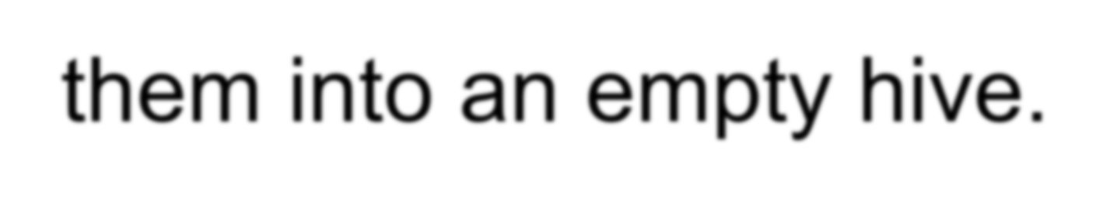
When bees swarms
We actually and actively catch them, and house them into an empty hive.

Slide 5

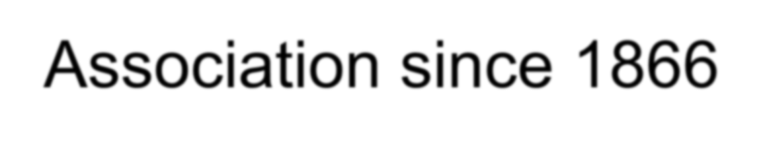


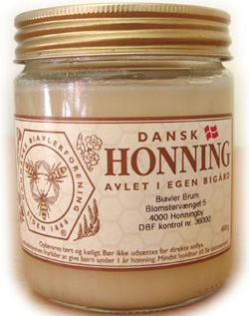


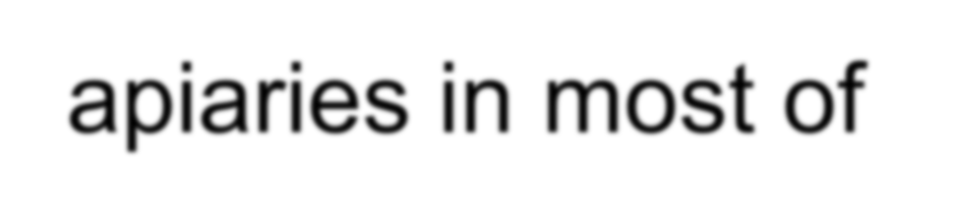



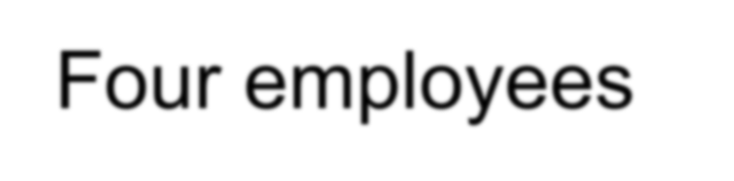
Denmarks Beekeeping Association since 1866
7000+ Members
Demonstration apiaries in most of Denmark
Old magazine New webpage Four employees

Slide 6

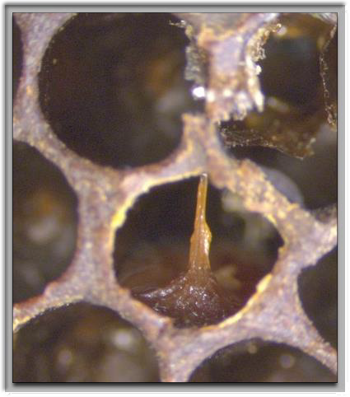

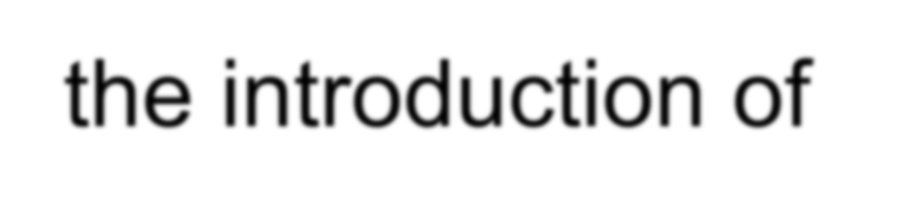
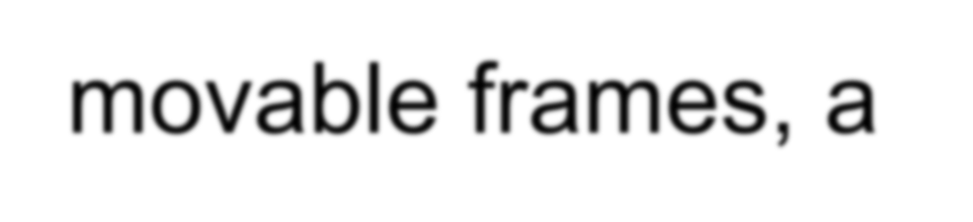
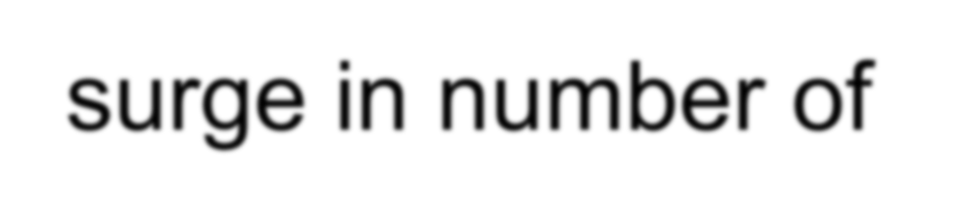


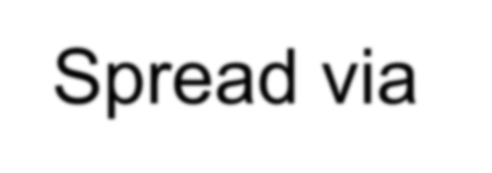
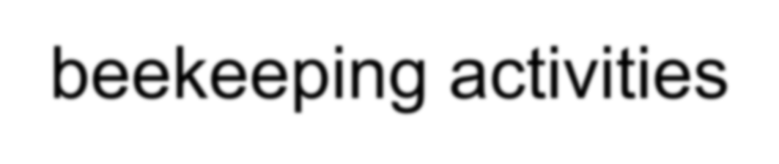
It started with AFB
In the years following the introduction of movable frames, a surge in number of colonies affected by AFB was seen.
Spread via beekeeping activities

Slide 7
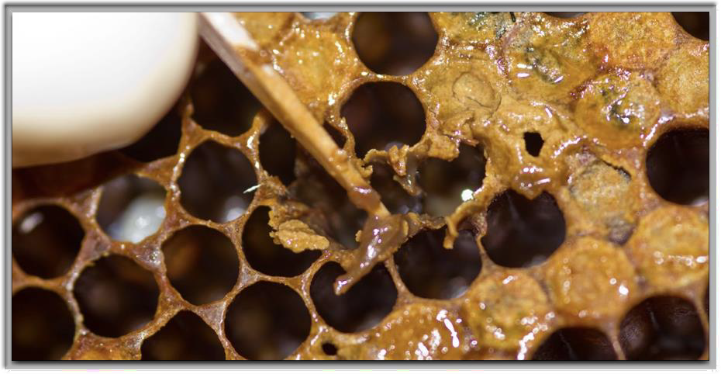
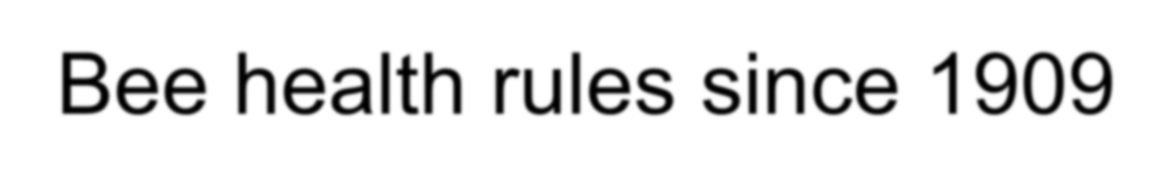
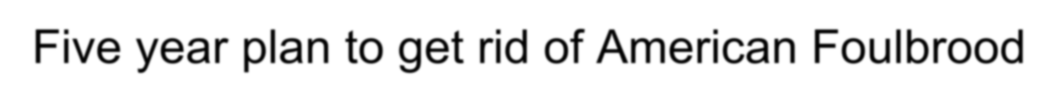

Bee health rules since 1909
Five year plan to get rid of American Foulbrood We are still working it

Slide 8
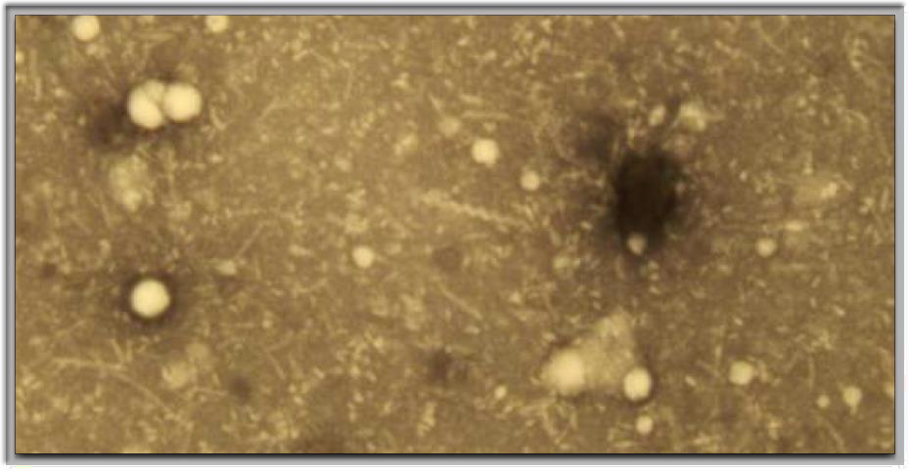

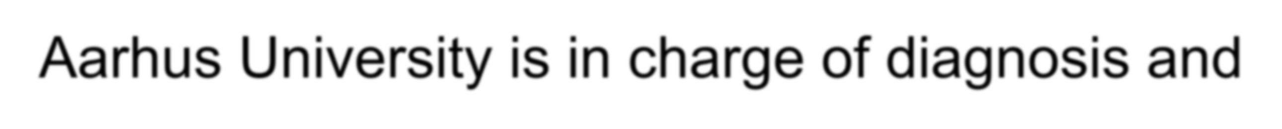

AFB diagnosis
Aarhus University is in charge of diagnosis and treatment of bee diseases

Slide 9

AFB since 1991
150
120
Apiaries
90
60
30
0
1991
1992
1993
1994
1995
1996
1997
1998
1999
2000
2001
2002
2003
2004
2005
2006
2007
2008
2009
2010
2011
2012
2013
2014
2015
2016
2017

Slide 10

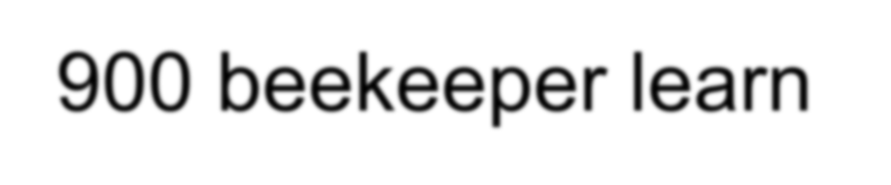
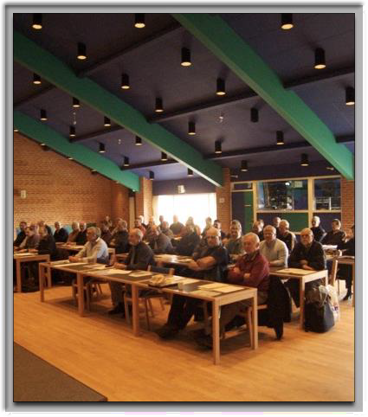
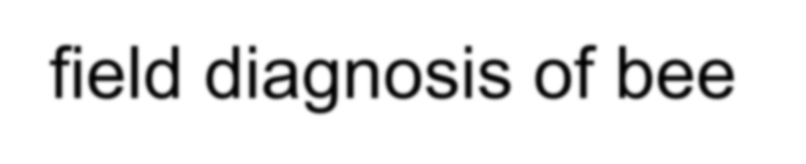
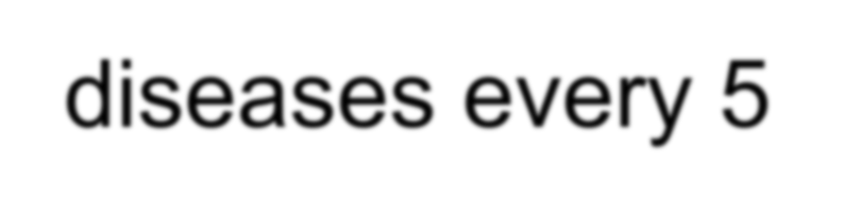


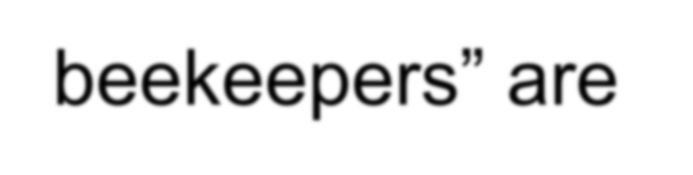




Bee disease course
900 beekeeper learn field diagnosis of bee diseases every 5 years
These “skilled beekeepers” are allowed to control colonies and fill in a health form for migration or trade

Slide 11

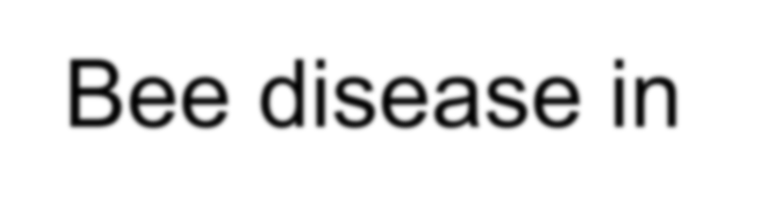
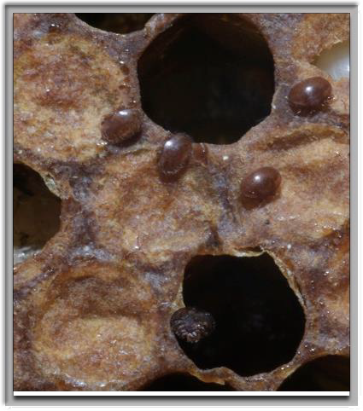

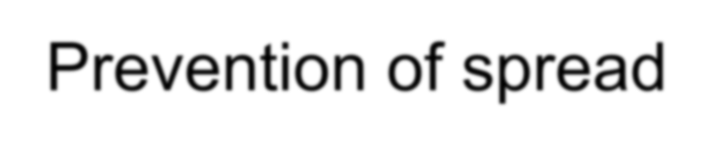

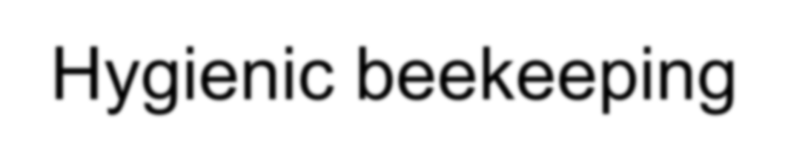
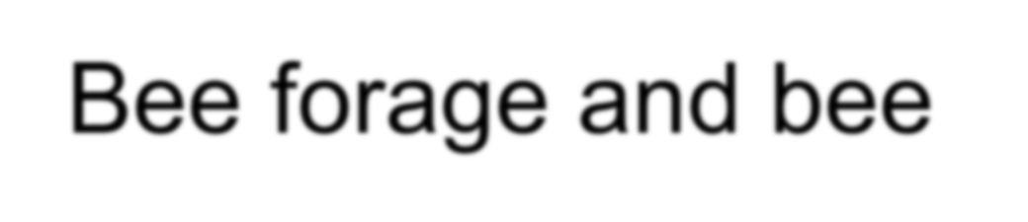
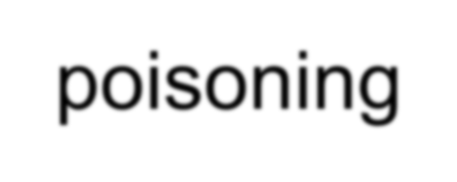

Main topics of the course
Bee disease in general
Prevention of spread Treatment
Hygienic beekeeping
Bee forage and bee poisoning
Law on beekeeping

Slide 12
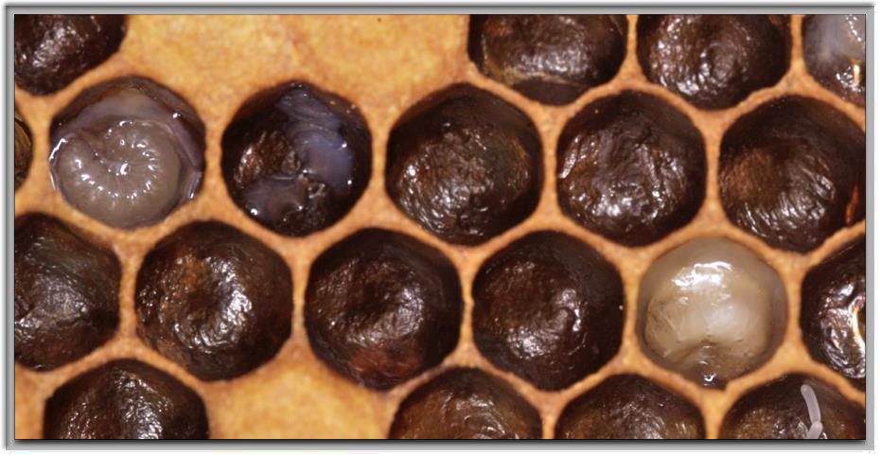

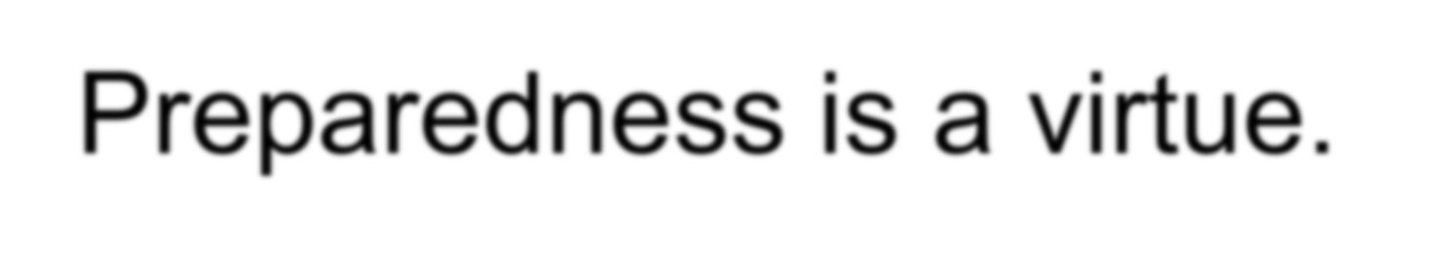
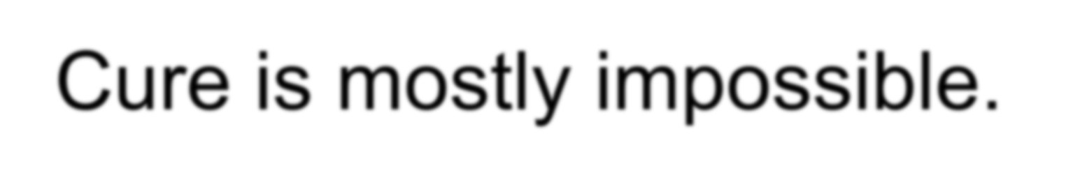
Prevention contra cure
Preparedness is a virtue. Cure is mostly impossible.

Slide 13
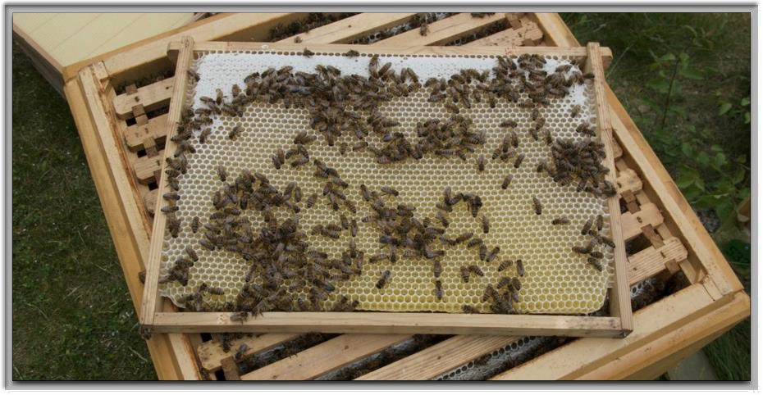

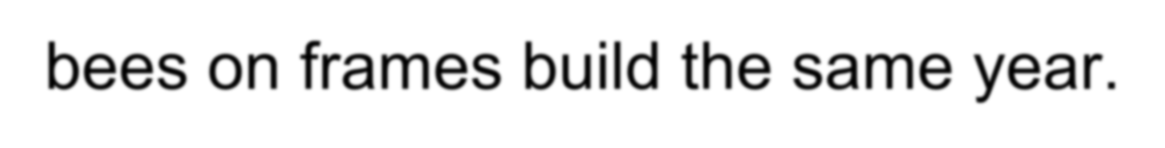
Wax is exchanged regularly
The general practise in Denmark is to winter the bees on frames build the same year.

Slide 14
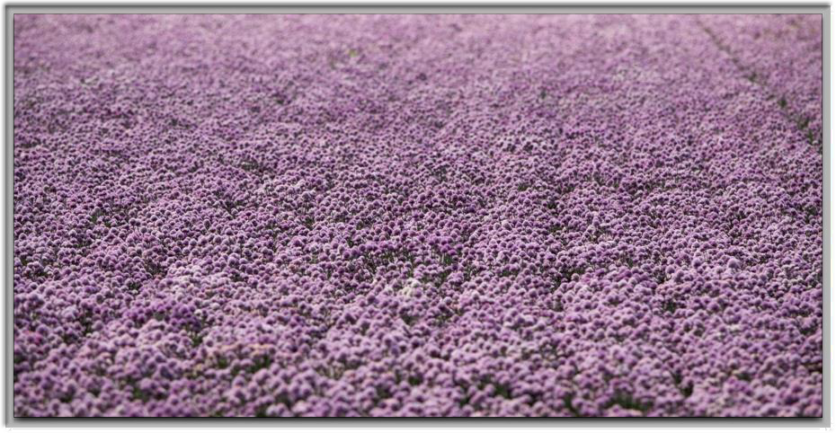


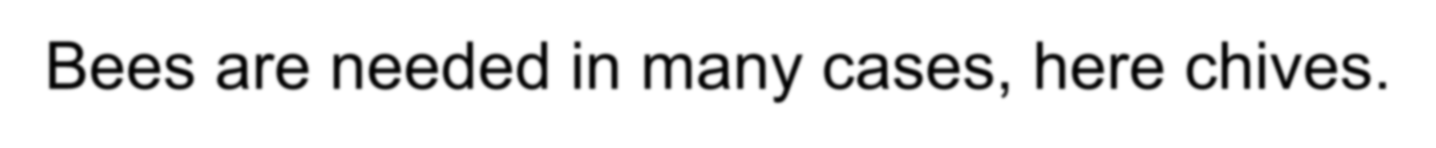
Pollination matters
Denmark is a major seed producer.
Bees are needed in many cases, here chives.

Slide 15

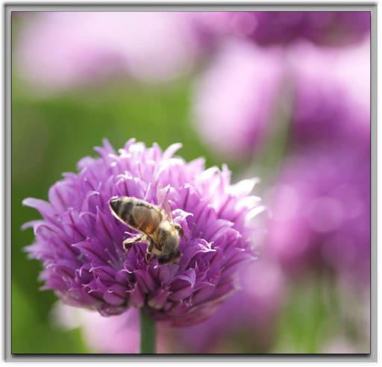
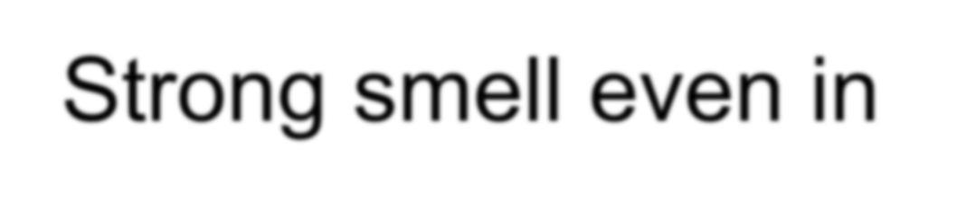
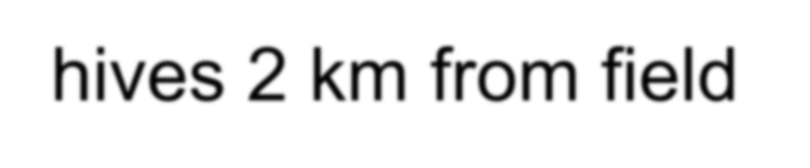
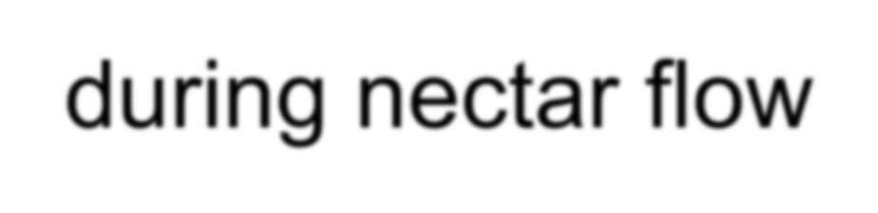

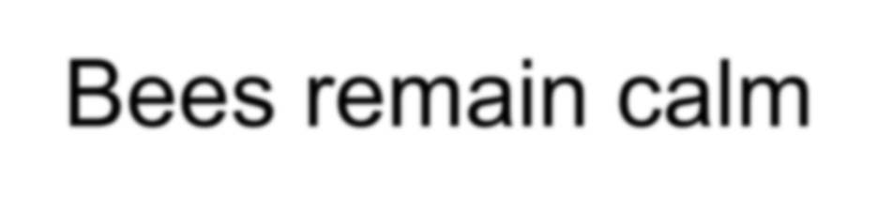
Chives a source for honey
Strong smell even in hives 2 km from field during nectar flow
Honey is fine mild Bees remain calm

Slide 16
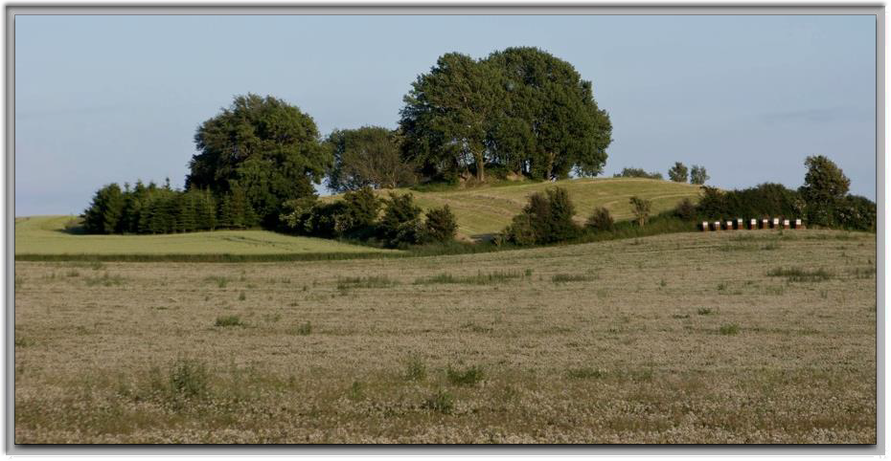


White clover important
Some years the beekeepers harvest honey, still the seed producer always pay pollination fee.

Slide 17


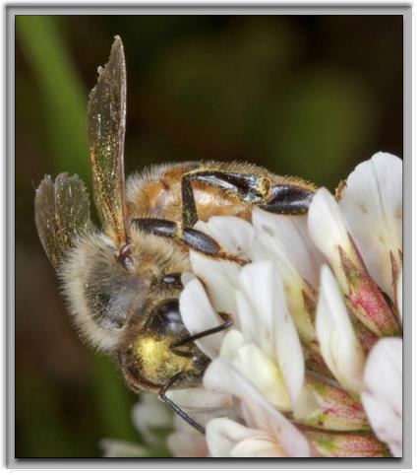








Mainly along the Great Belt
Climate conditions are important for nectar production
First real breeding in Denmark was to produce a white clover bee
Introduction of
A. m. ligustica

Slide 18










Queen breeders association of 1921
Organize courses and meetings to compare breeding material
Combination or hybrid bees are very popular
Testing of breeding stock and providing mating control

Slide 19







Hygienic behaviour test
Gentle bees No swarming Hygienic bees
Nosema tolerant Honey production

Slide 20



Thank you for the attention!
per.kryger@agro.au.dk

